Slide 1
CSE 3311 – 002 TEAM 8
Jared Kremer
Javier Gonzalez
Ayush Bhandari

Slide 2
Project vision
To design a music player application that delivers a dynamic learning experience on traditional physics subjects.

Slide 3
Client & Users
Our client for this project is a physics teacher named “Ray” at Pantego Christian Academy.
He wants a mobile application to be built for him and his students to showcase songs he has made over the units and topics of physics that he covers.
Students will then be able to choose a song among the listing.
Ray has about 10-11 songs picked out for this application. Most of them coming with cover art and some with visuals that can be presented when showcasing the lyrics.

Slide 4
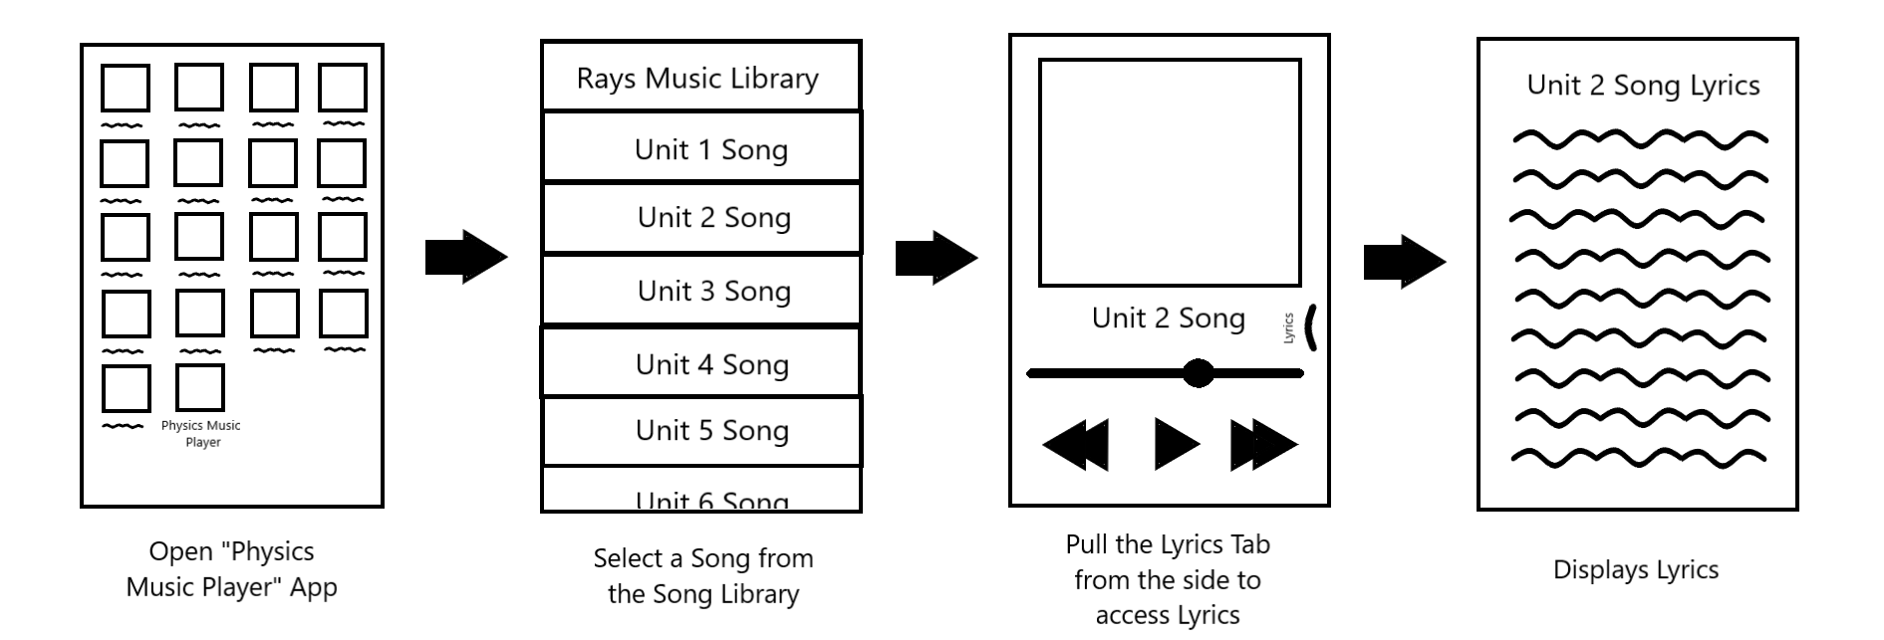
Physics Music Player

Slide 5
Features
The mobile application will be found in the Play store/Appstore.
The application will have a main menu which will showcase song listings available with cover art and name of the unit it covers.
When songs are clicked music will begin to play
With a separate tab for lyrics to follow along and some possible animations will appear in the background.
The application will be able to pause and skip around in the track
Lyrics already spoken will appear red or be marked
Return button will go back to previous screen
Users will have the option to scroll through the listing and choose a song to play next.

Slide 6
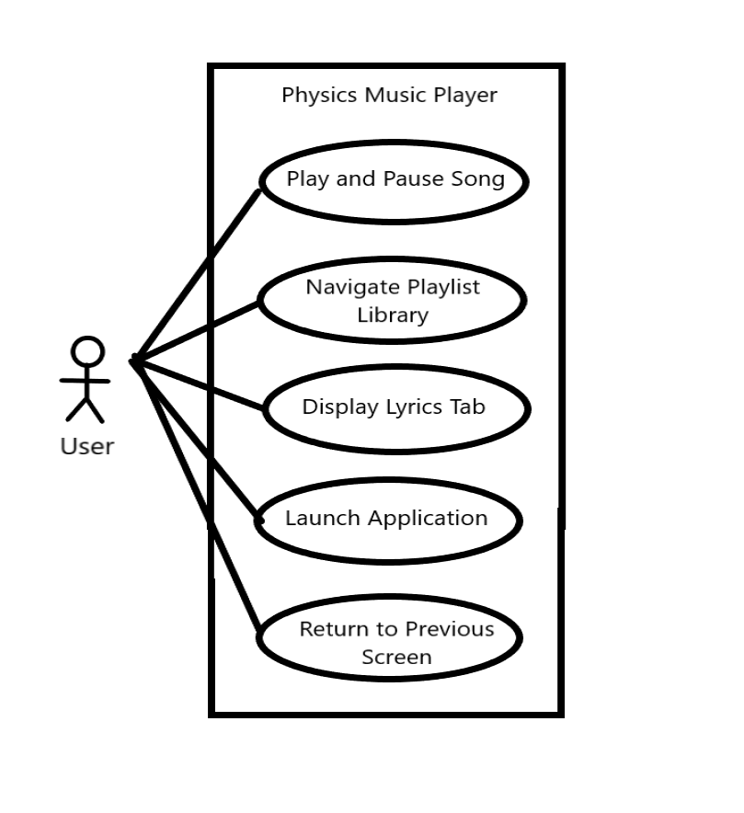
Use-case Model

Slide 7
Potential risks
Business Risks?
Customer could move away
Contact customer using remote meetings
Product could be too simple
Add backlog of extra features for implementation later
Songs or cover art aren’t delivered on time
A dud song will be implemented in the place of what the songs will look like in the application.
Resource Risks?
Team unfamiliar with Android Studio.
We will take personal time outside of group meetings to familiarize himself to it
Javier works part time/ full time.
Javier can relay his schedule to his team so they can work around it
Schedule Risks?
Iteration 2 deliverable date conflicts with midterm
Jared delivers his part earlier to avoid scheduling conflict

Slide 8
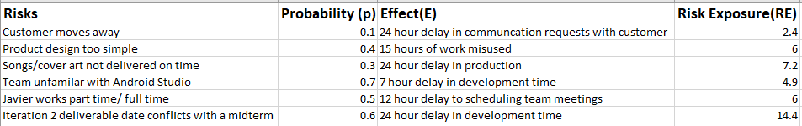
Risk table

Slide 9
competitors
Related Competitors : Karaoke Apps and YouTube
Description of Competitors:
Karaoke Apps : Smule(2008) and Starmaker(2010)
Social Media App based around singing. News Feed with Comment and React features.
Ad-based Free version
Paid VIP Access for Unlimited Songs, NO Ads, Full Songbook Access
Solo, Duet, and Group Sessions (VIP Access Required in Smule)
Age Restriction
YouTube Playlist
Link Access through a Brower or Search in the YouTube App
Ad in between videos

Slide 10
competitors
How is our app different from competitors?
Free and NO Ads
Educational Purposes only
Simple and Precise Design
Convenient than a website
Safer content than website or karaoke app.

Slide 11
Software development plan
Iteration Plan:
GUI Development
Tools:
Android Studio
People
Customer : Ray
Development Team : Jared Kremer, Javier Gonzalez, Ayush Bhandari
Testers: Ray's Students
Education
Learning Android studio specific GUI libraries
Interest in Physics topics mentioned in the application

Slide 12
Github link
https://github.com/UnclePhiI/CSE3311-TEAM-8
Version 1.0

Slide 13
references
Smule – The Social Singing App
Official Website: https://www.smule.com/
Starmaker – Sing Karaoke Songs
Official Website: https://www.starmakerstudios.com/#/
More info: https://apps.apple.com/us/app/starmaker-sing-karaoke-songs/id342138881

Slide 14
Thank you for listening!

